Slide 1
Group-15
Ayush Prasad - 202401100300086
Ashish Yadav - 202401100300076
Ayush Gupta - 202401100300084
Himanshu Singh - 202401100300125

Slide 2
Rain Prediction Model: A Classification Approach
Predicting tomorrow's rainfall using machine learning.
Leveraging historical weather data for accurate forecasts.
Enhancing decision-making in agriculture, transportation, and daily life.

Slide 3
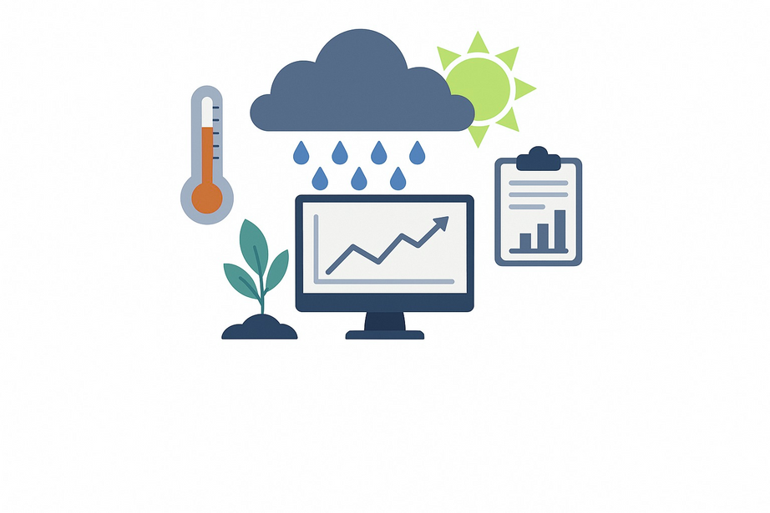
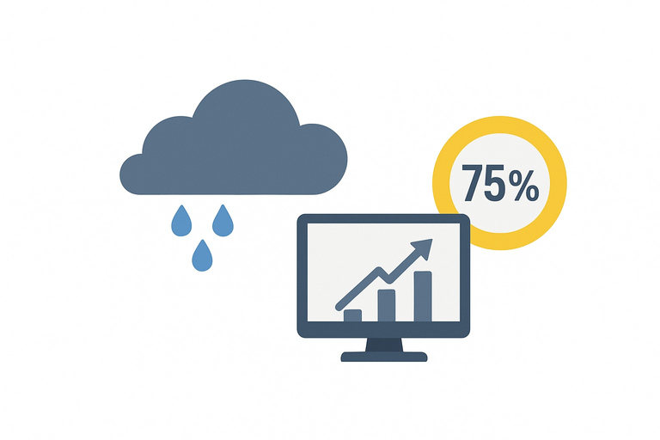
Challenge
Accurate rain prediction is critical for many sectors. Existing weather forecasts often lack precision.
Problem Statement
Goal
Develop a model for binary rain prediction (yes/no). Improve accuracy over existing methods (baseline 75%).

Slide 4

Kaggle Dataset
Kaggle Weather Dataset (Rattle Package) is our primary source.
1
Timeframe
Contains daily weather observations from 2008-2017.
Data Source
2
Location
Data is from multiple Australian weather stations.
3
Key Metrics
Includes temperature, pressure, humidity, and wind speed.
4

Slide 5




Data Preprocessing
Cleaning missing values and handling outliers.
Feature Engineering
Selecting relevant features and creating new ones.
Methodology: Classification Algorithms
Model Selection
Exploring Logistic Regression, Random Forest, SVM.
Validation
Training/testing split (80/20) with k-fold cross-validation.

Slide 6
Input Features
Features | Functions
Numerical | MinTemp, MaxTemp, Rainfall, Evaporation, Sunshine
Categorical | WindGustDir, WindDir9am, WindDir3pm, Location
Engineered | Seasonality, Temperature Range

Slide 7


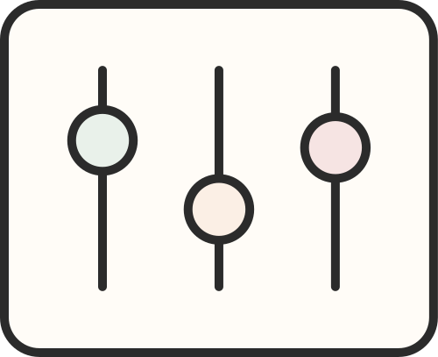





Hyperparameter Tuning
F1 Score
Harmonic mean of precision and recall. Essential for imbalanced datasets.
Using GridSearchCV/RandomizedSearchCV for optimal performance.
Model Training & Evaluation
AUC-ROC
Regularization
Area Under Receiver Operating Characteristic curve. Measures classifier performance.
Applying L1/L2 to prevent overfitting. Ensuring model generalization.

Slide 8
1
Effective Models
Classification models predict rain effectively.
2
Informed Decisions
Accurate predictions aid decision-making.
Conclusion
3
Future Enhancements
Incorporate real-time data, expand features.
4
Deployment
Deploy model as a web application for public access.

Slide 9
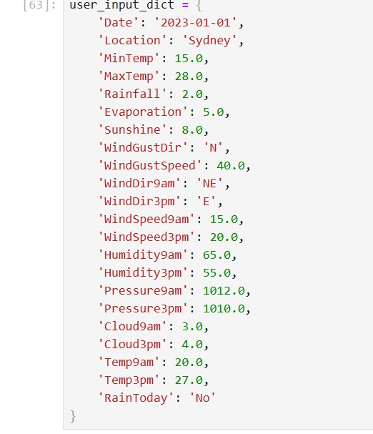
Input

Slide 10
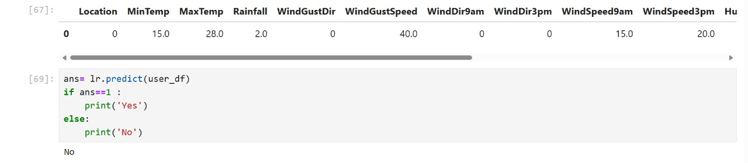
Output

Slide 11
Thank you!

